Slide 1
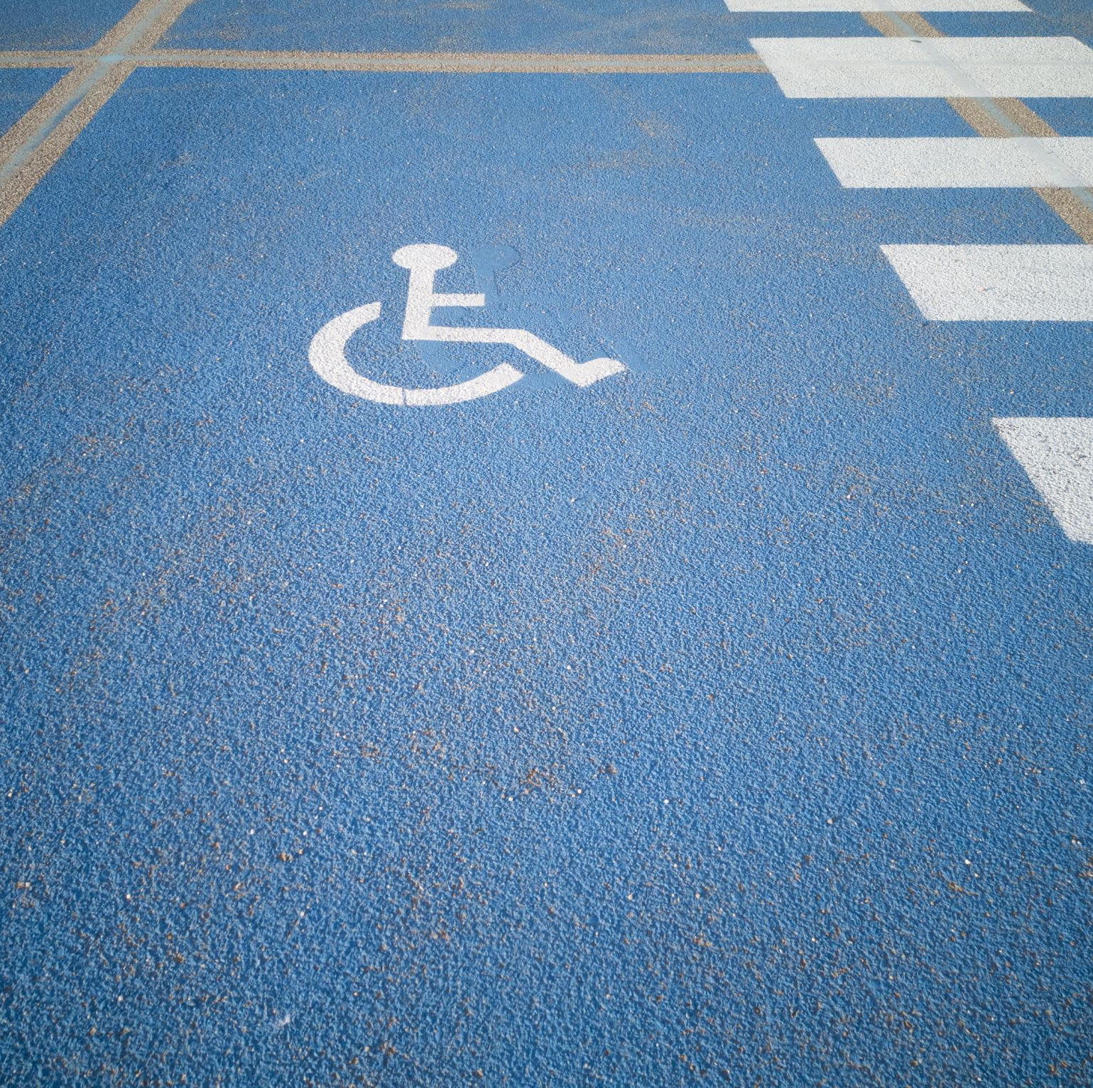
Improving Web Interface Accessibility for People with Motor Disabilities through Gesture Recognition
Team Members
Akhil Vemulapally
Bhanu Prasad Kandula
Sandeep Kumar Sutharapu

Slide 2
Research Question and Problem Scope
How could gesture recognition technology be effectively implemented to improve the accessibility of web interfaces for people with motor disabilities?
Problem Scope:
Accessibility Challenges
Limited Input Methods
Usability Issues

Slide 3

Motivation
Critical Evaluation of Existing Interfaces
Inspiration from HCI
Improving Accessibility
Recognition of Gesture Technology Developments

Slide 4
Literature Review Summary
Broad Problem Area – Accessibility Issues for PwD
Relevant Research Studies
Identified Gaps

Slide 5
Proposed Methodology
User Survey
Review of Gesture Recognition Technologies
Prototype Development and Testing
Implementation (HTML, CSS, JavaScript)

Slide 6
Inductive Analysis
Types of Motor Impairments
Challenges in Accessing Web Interfaces
Preferred Gestures for Web Interaction
Comfort Levels with Gestures
Feedback on Gestures

Slide 7
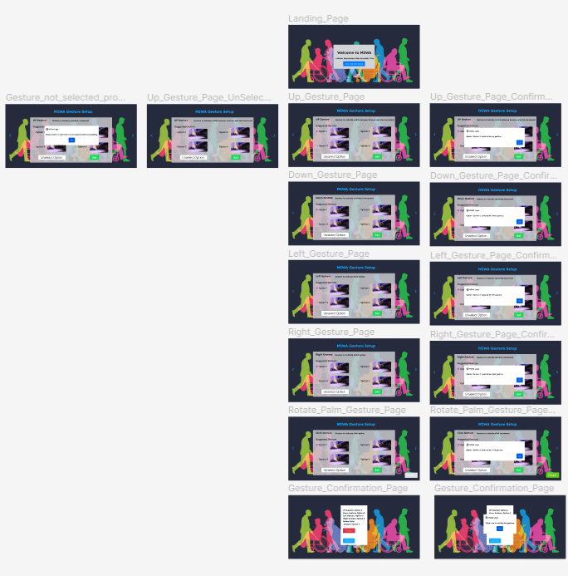
MIWA Tool Design Prototype
Figma Design Prototype Preview

Slide 8
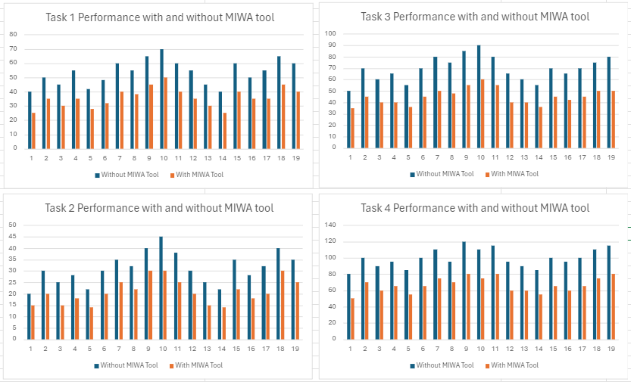
Quantitative Analysis
Participant Demographics
MIWA Tool Usage (Ease of Use Rating, Preferred Gestures)
Task Performance Comparison
Graphical Analysis

Slide 9
Task 1: Navigate to a specific webpage
Without MIWA Tool: Average time taken = 53.68 seconds
With MIWA Tool: Average time taken = 35.94 seconds
Task 2: Click on a specific button/link on the webpage
Without MIWA Tool: Average time taken = 31.15 seconds
With MIWA Tool: Average time taken = 20.94 seconds
Task 3: Fill out a form with predefined information on the webpage
Without MIWA Tool: Average time taken =69.47 seconds
With MIWA Tool: Average time taken = 45.10 seconds
Task 4: Scroll through a long webpage
Without MIWA Tool: Average time taken = 99.47 seconds
With MIWA Tool: Average time taken = 66.57 seconds
Ease of Use of MIWA Tool Rating: Average rating of 3.92 out of 5 indicates moderate ease of use.

Slide 10
Reflection
Address accessibility challenges for people with motor disabilities through gesture recognition in web interfaces
If more time, would consider:
User Centerer Design - Active user engagement & Qualitative evaluation.
Further explore advanced gesture recognition techniques (ML, wearables)
Allow customization and personalization of gestures.

Slide 11
Future Work
Expand to diverse use cases and application domains
Integrate with accessibility guidelines and standards
Collaborate with experts in assistive technology and rehabilitation
Explore multimodal interaction techniques
Conduct longitudinal studies for long-term usability assessment

Slide 12
Contribution
Bhanu Prasad Kandula – I have contributed to the Idea innovation, Literature review, User survey, Code for the Prototype, Quantitative analysis, Demo Video
Akhil Vemulapally – I have contributed to the Proposed Methodology, User survey ,Figma Prototype, Inductive analysis (Qualitative analysis), End user review report, Presentation
Sandeep Sutharapu – I have contributed to the Idea innovation ,literature review , user survey ,Figma Prototype, Inductive analysis (Qualitative analysis),End user review report, Discussion on HCI

Slide 13
Thank You!
-Team Trio

